Slide 1

Friday Brunch with the Office of Accessibility
Jessica DeFago, M.Ed
Director, Office of Accessibility

Slide 2

Jessica DeFago, M.A.,
Director
Leigh Sveda, B.A.
Adaptive Technology & Service Coor.
Tess Miller, M.Ed., CRC
Associate Director
Meet Our Team
Natalie Martin, B.A.
Office Manager
Heather Rose, M.A., CCC-SLP
Disability Specialist & Service Coor.
Rachael Kosar, B.S.
Captioning & Service Coor.
Julie Hartzler
Disability Specialist & Service Coor.
Wayne College and other Campus Locations

Slide 3

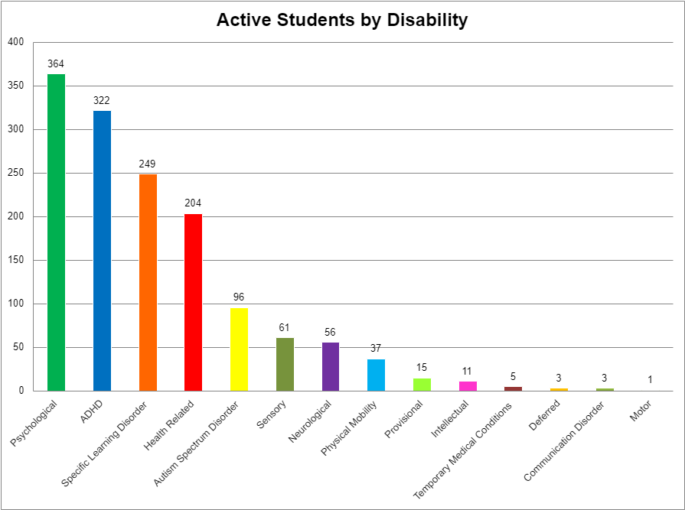
Office of Accessibility
student Population

Slide 4

Register with the OA
It’s As easy as 1-2-3
1
2
3
Application
Complete the online application at www.uakron.edu/access
Documentation
Submit current documentation from a qualified treatment professional
Guidelines are available at www.uakron.edu/access/forms
Appointment
Make an appointment to meet with a Disability Specialist to determine reasonable accommodations once required documentation is received

Slide 5

Supplements to Presentation:
Content Areas
Adaptive Technology
Alternative Media
Assignment Accommodations
Attendance Accommodations
Captioning
Classroom Accessibility
Graduation
Hearing Accommodations
Interpreters
Notetaking Accommodations
STARS
Testing
Virtual Transcription
Campus Partners
Checking Accessibility
Experiential Learning/ Supplemental Learning
Syllabus Statement
Links

Slide 6

Adaptive Technology
Dragon Naturally Speaking
Speech recognition software that delivers transcription three times faster than typing
JAWS (Job Access With Speech)
Screen reader that provides speech and Braille output for computer users whose vision loss prevents them from seeing screen content or navigating with a mouse
Kurzweil 3000
Provides reading, writing, and study platform for students where reading or writing is difficult
ZoomText
Magnification and reading software that enlarges and enhances everything on the computer screen
Special versions of already existing technologies or tools that provide enhancements or different ways of interacting with technology
Adaptive technology helps individuals with a disability or impairment accomplish specific tasks
Contact: Leigh Sveda lab10@uakron.edu

Slide 7

Alternative Media
The preparation of course materials in an accessible format for students with disabilities to access either via computer or Braille
For students to access alternative media, they must purchase the required course materials and request the accommodations through STARS
https://www.uakron.edu/access/docs/handbooks/Alternative%20Media%202020.pdf
Instructor Responsibilities
  Supply the bookstore with the course textbook information at least a month before the semester begins
Contact: Leigh Sveda lab10@uakron.edu

Slide 8
Assignment Accommodations
Assignment accommodations are available in cases where the impacts of disability may interfere with a student’s ability to meet assignment deadlines
Assignment accommodations should not interfere with the essential elements or fundamentally alter the requirements of a course or program
https://www.uakron.edu/access/docs/handbooks/Assigment%20Accommodations.pdf
Student Responsibilities
Discuss accommodations with instructor
Complete an Assignment Accommodation Instructor Agreement Form in their STARS student profile
Notify the instructor when instances occur that result in needing to use their assignment accommodation
Instructor Responsibilities
Meet with student and determine a plan for how the accommodation will function in the course
Review Assignment Accommodation Instructor Agreement Form copy that will be emailed and notify the student of any edits that need to be made
Consult with the Office of Accessibility or student's assigned Disability Specialist if needed
Consultation between the Office of Accessibility, the student, and the instructor, to determine what constitutes as reasonable flexibility and what qualifies as the essential elements of the course, is encouraged
Contact: Student's Assigned Specialist

Slide 9
Attendance Accommodations
Attendance accommodations are available in cases where the impacts of a disability may interfere with a student's ability to attend or remain in class
Attendance accommodations should not interfere with the essential elements or fundamentally alter the requirements of a course or program
https://www.uakron.edu/access/docs/handbooks/Attendance%20and%20Disability%202021.pdf
Student Responsibilities
Discuss accommodations with instructor
Complete an Attendance Accommodation Instructor Agreement Form in their STARS student profile
Notify the instructor when instances occur that result in needing to use their attendance accommodation
Instructor Responsibilities
Meet with student and determine a plan for how the accommodation will function in the course
Review Attendance Accommodation Instructor Agreement Form copy that will be emailed and notify the student of any edits that need to be made
Consult with the Office of Accessibility or student's assigned Disability Specialist if needed
Consultation between the Office of Accessibility, the student, and the instructor, to determine what constitutes as reasonable flexibility and what qualifies as the essential elements of the course, is encouraged
Contact: Student's Assigned Specialist

Slide 10

Captioning
  Captioned course videos are accommodations offered to approved students through the Office of Accessibility
  This accommodation requires an OA staff member to be a part of the course, send the videos to our captioning company (Verbit), and make sure the student receives the captioned video
  Students will have the videos for the remainder of the semester for their reference
  https://www.uakron.edu/access/docs/handbooks/Captioning%202020.pdf
  Instructor Responsibilities:
    Alert the captioning and service coordinator if they are using prerecorded media
    Allow at least 3 business days for videos to be captioned before needing them for class
Contact: Rachael Kosar rkk11@uakron.edu

Slide 11
Classroom Accessibility
  Classroom accessibility is coordinated by the Office of Accessibility for students with approved accommodations
  These accommodations can include seating arrangements, physical classroom accommodations, relocating courses, and course lock-ins
  Course relocation allows the student to stay in the same building or in buildings that are close together
  If courses get locked-in, they cannot be moved to a new building or even room unless the student is first consulted and if they approve of the move
  https://www.uakron.edu/access/docs/handbooks/Campus%20and%20Classroom%20Accessibility%202019.pdf
  Instructor Responsibilities:
    Leave any furniture as is when it is marked as accessible furniture by Physical Facilities
    Replace any accessible furniture where it was found if it was moved
Contact: Rachael Kosar rkk11@uakron.edu

Slide 12

Graduation
The Office of Accessibility coordinates interpreting and live transcription for graduation ceremonies at the University of Akron
Staff and/or agency interpreters are secured for the ceremonies with live transcription available on the University of Akron YouTube channel during the ceremony
Physical accessibility needs are also discussed with the graduation committee
Contact: Jessica DeFago jld4@uakron.edu or Heather Rose hrose@uakron.edu

Slide 13


Hearing Accommodations
The Office of Accessibility coordinates services for approved students who are hard-of-hearing or Deaf
Audio accommodations can include interpreting services, transcription services, clear window masks, sound-field accommodations, and assistive listening technology
https://www.uakron.edu/access/docs/handbooks/Assistive%20Listening%20Device-Personal%20Listening%20Device.pdf
https://www.uakron.edu/access/docs/handbooks/Assistive%20Listening%20Device-Sound%20Field2021.pdf
Instructor Responsibilities:
  Pick up any audio equipment needed for the student's accommodation
  Wear a clear-window mask to maximize visual cues
Contact: Heather Rose hrose@uakron.edu

Slide 14
Interpreters
The Office of Accessibility has two staff American Sign Language interpreters and contracts with two community agencies
Coordination for approved students is completed by the Office of Accessibility
Interpreters are provided either in-person or virtually
Securing chairs through Physical Facilities can be coordinated by the Office of Accessibility if needed
https://www.uakron.edu/access/docs/handbooks/Sign%20Language%20and%20oral%20Interpreters%202019.pdf
Instructor Responsibilities:
  Add interpreters as an observer to Brightspace so they can have access to materials and terms
  Provide the Teams room link if the interpreter is providing services virtually
Student Responsibilities:
  Long-term requests must be completed at least four weeks prior to the beginning of the semester
  One-day requests must be completed at least five business days before the interpreter is needed
  Bring a lap-top if the accommodation is being met virtually for in-person classes
Contact: Heather Rose hrose@uakron.edu

Slide 15
Notetaking Accommodations
  Notetaking accommodations are coordinated by the Office of Accessibility for approved students who request a peer notetaker in their class
  The notetaking coordination process involves:
    Contacting instructors to determine if the course has a notetaking component and to verify the need for a peer notetaker
    Sending two rounds of recruitment emails to the class list
    In-person classroom notetaking recruitments as needed
    To assist in the process of fulfilling notetaking accommodation requests, instructors can:
      Share the notetaker recruitment announcement with their class (via email, Brightspace post, or verbal announcement) when the Office of Accessibility contacts them about the need for a notetaker in their course.
    In cases where no notetaker is found after following all recruitment steps, instructors are asked to share copies of their instructor notes with the student and permit use of the audio recorder accommodation, so the student can use these accommodations in place of a peer notetaker, to supplement their own notes
    https://www.uakron.edu/access/docs/handbooks/Notetaking%202020.pdf
Contact: Tess Miller tmiller1@uakron.edu

Slide 16

STARS
The Office of Accessibility utilizes a web-based Student Testing and Accommodation Request System (STARS) to better aid and support students in a more seamless and efficient manner
COMING SOON!
The Instructor Portal

Slide 17
Testing
  Alternative testing accommodations are some of the most used accommodations through the Office of Accessibility
  Alternative testing often includes time extensions, testing in a distraction reduced space, and the use of technology or a reader/scribe during testing
  https://www.uakron.edu/access/docs/handbooks/Testing%20Accommodations%202021.pdf
Student Responsibilities
Talk to faculty members to determine if they will be testing in their distraction reduced space in Simmons Hall, or if the faculty member can meet their accommodations in a different location
Schedule testing appointments to test in their distracted reduced space by submitting a testing request in our online system (STARS) at least 4 business days in advance
Instructor Responsibilities
Complete the Alternative Testing Agreement form as soon as possible after receiving the student’s letter of accommodation
Send the student’s testing location in Simmons a copy of the exam (if applicable) at least one day before the exam whenever possible
  Exams can be e-mailed, dropped off in person, or uploaded via the secure link in the testing appointment notification email received
Contact: Natalie Martin nab87@uakron.edu

Slide 18
Virtual Transcription
  Virtual transcription is an accommodation provided through the Office of Accessibility for approved students and their courses
  The new process of transcription is free through Microsoft Teams
  The student brings a laptop to class, the professor wears a microphone for clarity, and as the professor speaks the student gets a transcript on their computer through a private room on Teams
  https://www.uakron.edu/access/docs/handbooks/Transcriber%20Accommodations2020.pdf
  Instructor Responsibilities:
    Wear a microphone when lecturing to improve the accuracy of the transcription (These can be borrowed from our office)
    Allow the staff transcriber access to Brightspace so they can familiarize themselves with terms/language if providing services virtually
    Send the Teams room link to the staff transcriber if providing services virtually
    Read our Teams transcription guide
Contact: Rachael Kosar rkk11@uakron.edu

Slide 19

Vision Accommodations
The Office of Accessibility coordinates services for students in need of vision accommodations
This may include providing screen readers, speech to text, magnifiers, a CCTV, zoom technology and campus walk-throughs.
Contact: Heather Rose hrose@uakron.edu

Slide 20
Campus Partners
Counseling and Testing Center:
  Free and confidential personal, career, group, and educational counseling for current students.
  Proctoring services are available for a wide variety of exams, including prior learning, certification, admissions, and more.
College2Careers:
  Opportunities for Ohioans with Disabilities (OOD) now has an OOD College2Careers counselor onsite at The University of Akron! Partnership between the State of Ohio's Opportunities for Ohioans with Disabilities, Ohio’s state college and university system, including The University of Akron, and Ohio businesses offering college to career services for students with disabilities. A College2Careers counselor is now located at The University of Akron - Mara Byers Mara.Byers@ood.ohio.gov - website https://uakron.edu/career/c2c/
  Provide additional supports for UA students with disabilities
  Career exploration & career counseling
  Assistive technology
  Internships & permanent employment resources
  Connection to an expansive employer partner network
Equal Employment Opportunity/Affirmative Action:
  The University of Akron is an equal education and employment institution operating under nondiscrimination provisions of Title 41, Ohio Revised Code; Titles VI, VII of the Civil Rights Act of 1964, as amended; and Title IX of the Educational Amendments of 1972, as amended; Executive Order 11246, as amended; Vocational Rehabilitation Act section 504; Vietnam Era Veterans' Readjustment Act, as amended; Age Discrimination in Employment Act of 1967, as amended; Title II of the Genetic Information Nondiscrimination Act of 2008; and Americans with Disabilities Act, as amended as related to admissions, treatment of students, programs and activities, and employment practices.
  The EEO Director serves as the coordinator for concerns under these laws involving employees or third parties to campus. To file a complaint or for more information regarding these protections, please contact Tami Hannon, Director EEO/AA, (330)972-7300 or EEOCompliance@uakron.edu / website https://www.uakron.edu/hr/eeoaa/

Slide 21
Checking Accessibility
  To check the accessibility of PowerPoints and Word documents (via Microsoft), follow the steps below:
    Click “Review” (top toolbar)
    Click “Check Accessibility”
    Errors will appear in a sidebar
    Clicking arrow to the side will show more detail per error
    Navigate to “Additional Information” (directly below)
    Scroll to the bottom to gain insight as to how to correct the error
How to Check Accessibility in Word or PowerPoint: https://www.uakron.edu/access/docs/forms/Checking%20Accessibility.pdf

Slide 22
Experiential Learning and/or Supplemental Learning
  The Office of Accessibility recommends that courses which have out of classroom experiences such as internship, Co-op, and clinical settings utilize the Experiential Learning and/or Supplemental Learning Statement in conjunction with the Standard Syllabus Statement
  The Office of Accessibility recommends the following Experiential Learning and/or Supplemental Learning Statement:
    The information contained in accommodation letters is limited to classroom accommodations only. Internship, co-ops, clinicals and other out of classroom learning experiences are often very different than a typical classroom format. As a result, the University recognizes the types of academic accommodations reasonable for these experiences will often differ from those used in the classroom setting. Any student who feels he/she may need an accommodation based on the impact of a disability should contact the Office of Accessibility at 330-972-7928 (v), 330-972-5764 (tdd) or access@uakron.edu. The office is located in Simmons Hall Room 105.

Slide 23
Syllabus Statement
  In continuing to provide a welcoming campus environment, while promoting equal access for students enrolled at The University of Akron, the Office of Accessibility recommends all faculty include a standard syllabus statement for academic accommodations in each course they instruct
  There are several reasons why a standard syllabus statement is critical:
    It normalizes the accommodation process and helps to create a positive and welcoming environment for students with disabilities.
    It creates a collaborative vehicle for making legally mandated accommodations.
    It serves to educate students who need accommodations that arrangements can be made through the Office of Accessibility.
    For students who are registered with the Office of Accessibility, it serves as a reminder to request their accommodations.
  The Office of Accessibility recommends the following syllabus statement:
    In pursuant to University policy #3359-38-01, The University of Akron recognizes its responsibility for creating an institutional atmosphere in which students with disabilities have the opportunity to be successful. Any student who feels he/she may need an accommodation based on the impact of a disability should contact the Office of Accessibility at 330-972-7928 or access@uakron.edu. The office is located in Simmons Hall Room 105.
    After the student’s eligibility for services is determined, his/her instructors will be provided a letter which will outline the student’s accommodations.
  Implementing a universal standard syllabus statement ensures that the statement is written in non-discriminatory language and provides all the necessary information for a student to contact the Office of Accessibility to discuss the process for receiving accommodations

Slide 24
Links
Home Page: https://www.uakron.edu/access/
Registration Process: https://www.uakron.edu/access/students/registering/
Information for faculty and staff: https://www.uakron.edu/access/faculty-and-staff/
Accessibility policies: https://www.uakron.edu/access/students/policies/
Animal Guidelines: https://www.uakron.edu/access/docs/forms/Finalized%20Animal%20Guidelines.pdf
Emotional Support Animals (ESA) Procedures: https://www.uakron.edu/access/docs/forms/Edited%20-%20Emotional%20Support%20Animals%20(ESA)%20Procedures.pdf
Documentation Guidelines: https://www.uakron.edu/access/forms/
Handbooks and Supplements: https://www.uakron.edu/access/forms/
Student Handbook Supplements: https://www.uakron.edu/access/forms/
How to Check Accessibility in Word or PowerPoint: https://www.uakron.edu/access/docs/forms/Checking%20Accessibility.pdf
Wayne College: https://wayne.uakron.edu/student-services/accessibility-services/new-student-instructions
Julie Hartzler, Wayne College and other Campus Locations
Disability Specialist and Service Coordinator
330-684-8923
julie21@uakron.edu
Web Page: https://wayne.uakron.edu/student-services/accessibility-services/new-student-instructions

Slide 25
Thank You!
Jessica DeFago, Director
  jld4@uakron.edu
Office Information:
  Phone: 330-972-7928
  Email: access@uakron.edu
  Location: Simmons Hall 105
Presentation Designed by: Lauren Cummons, Student Assistant

